Slide 1
Predictive Data Analytics with PySpark

Slide 2
Data Analytics
The process of discover meaningful patterns in data
Raw data by themselves may not be too useful nor interesting
It is our task to make sense of the data and discover meaningful patterns
Student ID | Study Time | Sleep Time | Grade
001 | 5 | 8 | 3
002 | 8 | 5 | 3.6
003 | 3 | 11 | 2.2
004 | 4 | 8 | 2.4
005 | 1 | 6 | 1.2
006 | 7 | 8 | 3.75
007 | 6 | 7 | 3.1
$$grade=0.297+0.38t_{study}+0.081t_{sleep}$$
***This is a toy example and neither the data nor the result are from actual studies

Slide 3
Machine Learning Data Analytics
Data: collections of students and their grades, study times, and sleep times
Machine learning analytics refers to the use of algorithms that can automatically learn from data to solve a given task
Machine learning model: a specific instance of a ML algorithm
Training: the process of having a model learn from data to solve its given task
Student ID | Study Time | Sleep Time | Grade
001 | 5 | 8 | 3
002 | 8 | 5 | 3.6
003 | 3 | 11 | 2.2
004 | 4 | 8 | 2.4
005 | 1 | 6 | 1.2
006 | 7 | 8 | 3.75
007 | 6 | 7 | 3.1
Task: Predicting grade based on time students’ sleep time and study time
Training: model learns an accurate mapping between study time and sleep time to grade
Model: A specific neural network
Student ID | Study Time | Sleep Time
001 | 5 | 8
002 | 8 | 5
003 | 3 | 11
004 | 4 | 8
005 | 1 | 6
006 | 7 | 8
007 | 6 | 7
Pred. Grade
2.8
3.7
2.1
2.5
1.3
3.9
2.9
After training: model can make accurate prediction on new data
Student ID | Study Time | Sleep Time
008 | 2 | 4
009 | 9 | 4
Pred. Grade
3.1
3.2

Slide 4
Dataset
Collection of data that follows a similar template
In this module, we focus on tabular datasets
Also called structured data – a dataset is organized as rows and columns
Rows represent specific objects (instances, samples) in the data
Columns represent features (attributes, variables) in the data
Columns represent features
Rows represent users
#Account | Balance | 3-month past due | 6-month past due | Credit Standing
3 | 120 | 0 | 0 | Good
1 | 100 | 120 | 0 | Good
5 | 1000 | 600 | 300 | Bad
3 | 300 | 100 | 0 | Bad
A dataset on credit rating

Slide 5
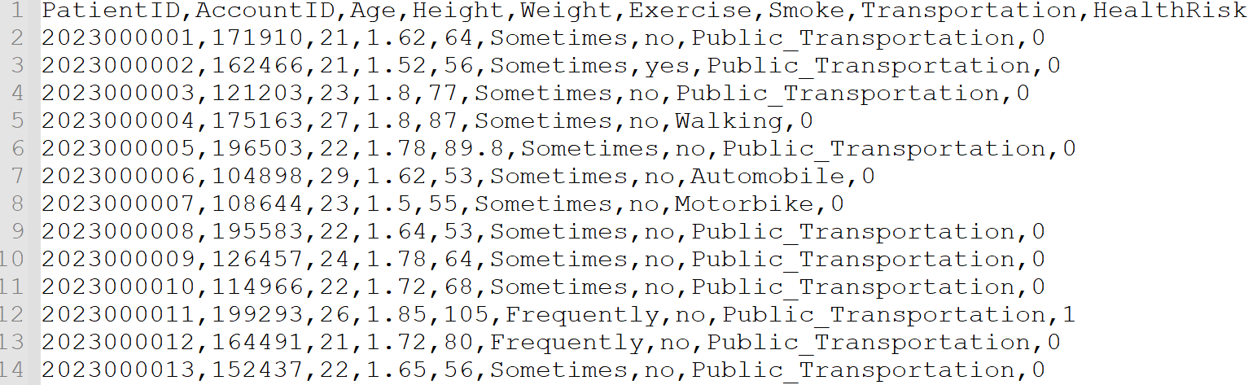
Comma Separated Value (CSV) Files
The most basic way to store structured data
Each line represents one row in data
First line is usually columns’ names (headers)
Fields are separated by commas

Slide 6
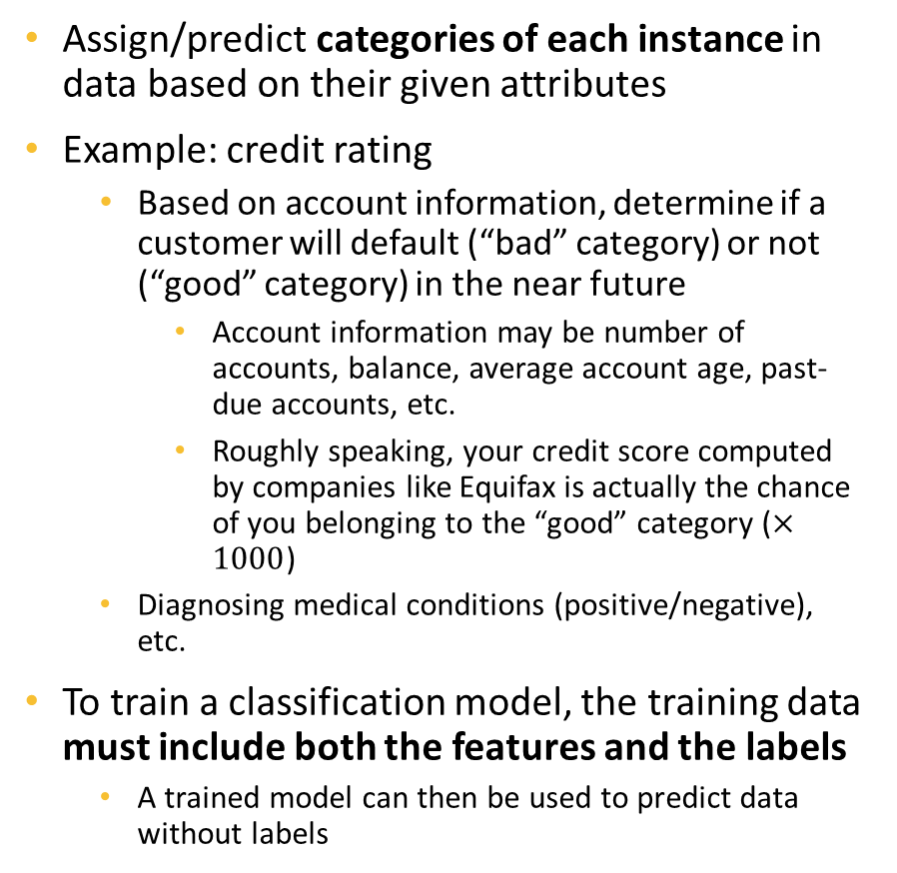
Classification
Enc_SSN | NoOfAcc | Balance | 3MnPstDue | 6MnPstDue
Ad9asgvjabl | 3 | 100 | 0 | 0
CLvb0das9b | 1 | 2500 | 1000 | 500
MCdfasd924 | 4 | 50 | 0 | 0
Mx9ta9fgak4 | 2 | 1200 | 200 | 0
Ro04ik2lv90 | 4 | 200 | 50 | 0
Class
Good
Bad
Good
Good
Good
Assign/predict categories of each instance in data based on their given attributes
Example: credit rating
Based on account information, determine if a customer will default (“bad” category) or not (“good” category) in the near future
Account information may be number of accounts, balance, average account age, past-due accounts, etc.
Roughly speaking, your credit score computed by companies like Equifax is actually the chance of you belonging to the “good” category ($×1000$)
Diagnosing medical conditions (positive/negative), etc.
To train a classification model, the training data must include both the features and the labels
A trained model can then be used to predict data without labels
Must provide both to train models
Enc_SSN | NoOfAcc | Balance | 3MnPstDue | 6MnPstDue
Ad9asgvjabl | 4 | 150 | 0 | 0
CLvb0das9b | 1 | 5000 | 3000 | 1000
Predict
Good
Bad
Only needs feature data to make predictions

Slide 7
Regression
Fairly similar to classification, however, the target to predict is of numeric types
Example:
Predict monthly product sales based on product types, categories, advertising spends, etc.
Predict first year GPA based on students’ majors and high school grades in different classes
Predict wildfire area based on location and weather
Etc.
Similar to classification, to train a regression model, the training data must include both the features and the labels
Classification and regression both belong to Supervised Learning – a branch of machine learning in which models need both features and labels to learn
Classification and regression are also considered predictive analysis
StudentID | Major | HSMath | HSEnglish | HSScience
001 | IT | 3.5 | 3 | 3.4
002 | CS | 3.5 | 3.6 | 3.6
003 | IT | 3.0 | 3.1 | 2.8
004 | SWE | 2.9 | 2.8 | 2.9
005 | BIO | 3.1 | 3.2 | 3.1
FYGPA
3.2
3.7
2.9
2.9
3.2

Slide 8
Steps in an Analytical Project
Minimally, an analytical project has the below steps
Form the project
Establish the question to solve like what to model or to explain
Determine a dataset that is able to address the analysis.
Data processing
Transform the data to address any issues
Modeling
Select the appropriate models for the data and the task,
Train/finetune the models
Publish the results
Document any findings or well-trained models from the previous steps
This module focuses on step 2
Next module focuses on step 3

Slide 9
Processing Steps Discussed
Loading data
Fix column types
Drop unnecessary columns
Train test splitting
One hot encoding
Imputation
All can then be wrapped in a single object called Pipeline
Before move to the working with dataframe notebook we will set up the environment in the next few slides

Slide 10
Install Numpy
PySpark machine learning requires Numpy to run, so we need to install it
Go to localhost:4200, log in as maria_dev/maria_dev
Run the below command
sudo yum install -y numpy

Slide 11
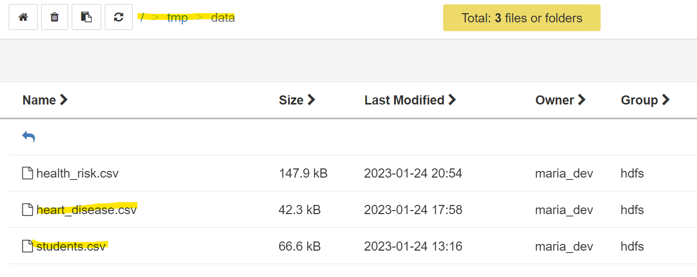
Upload Data and Import the Notebook
Upload students.csv and heart_disease.csv to your /tmp/data/ HDFS folder
If the heart_disease.csv file is there from the previous assignment, remove it and reupload the new file
We will start with the working with dataframe notebook
Please follow the instruction in the previous module to import and open the notebook

Slide 12
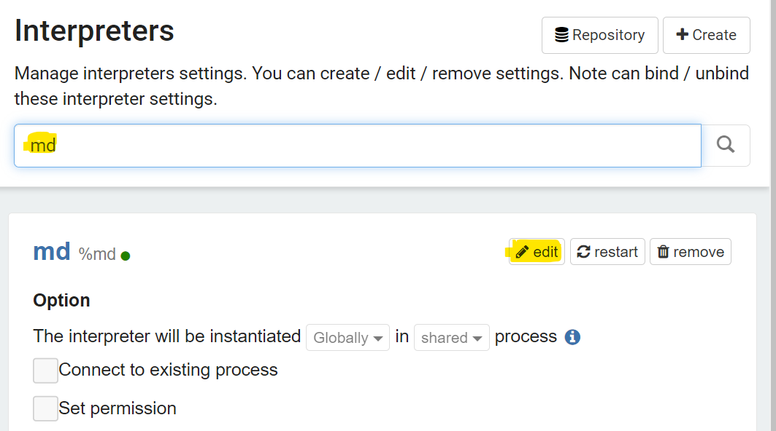
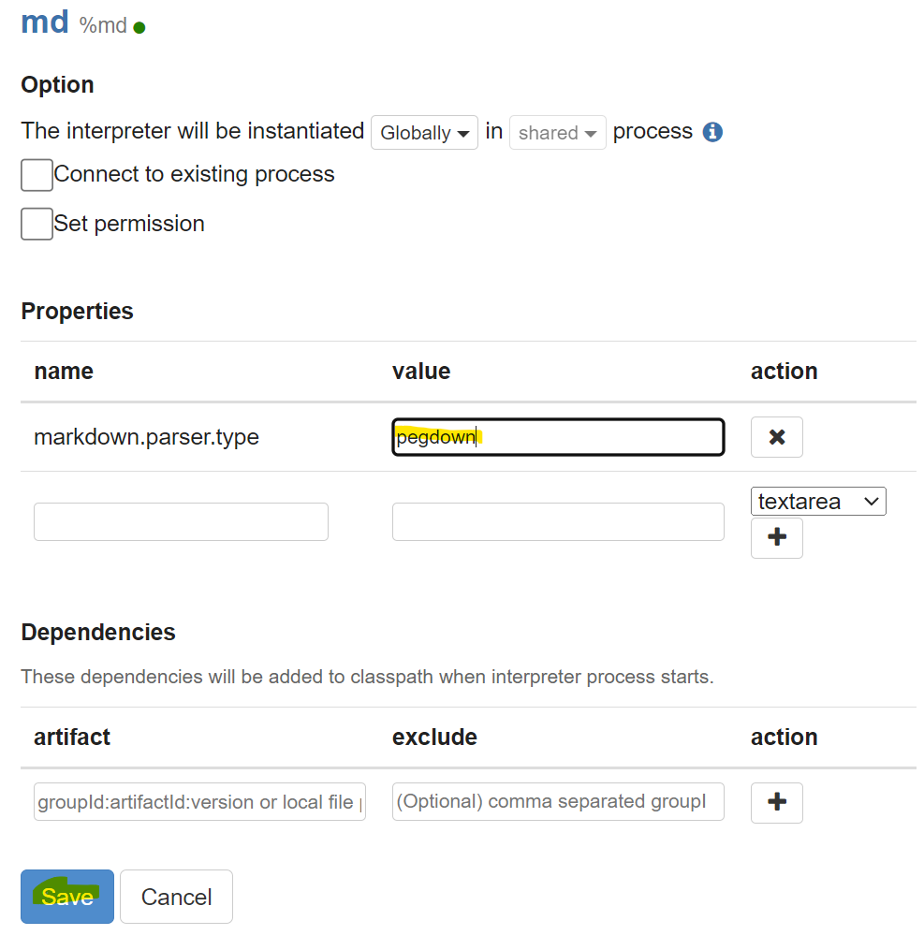
Set up the Mark Down Interpreter
All notebooks provided in this module use mark down interpreters to describe/explain the contents
To set up
Go to http://localhost:9995/#/interpreter
Search for md
Select edit
Change the value to pegdown
Save the change

Slide 13
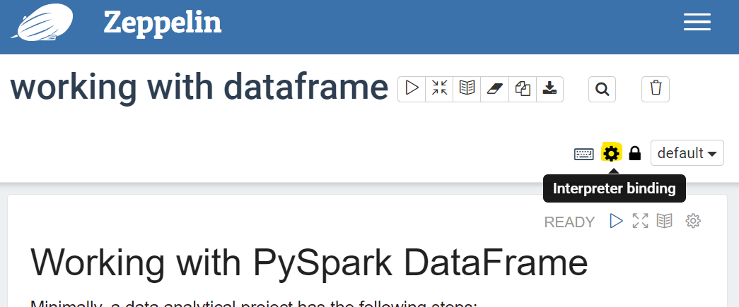
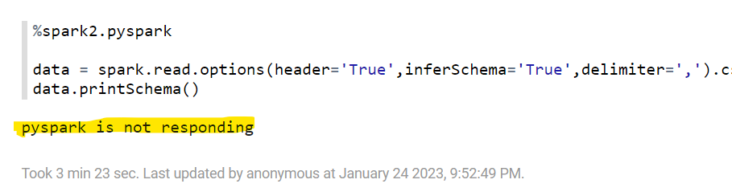
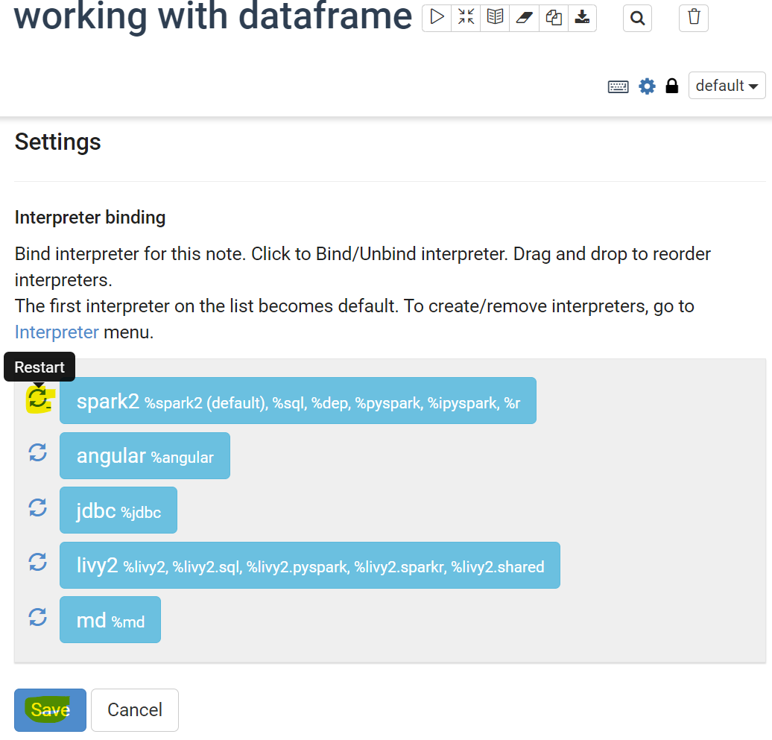
When PySpark not responding
You may occasionally see the message pyspark is not responding
In such cases, reset the interpreter
Click on Interpreters Binding
Click on the reset button next to spark2
Save the change

